Slide 1
Chapter Five
Consumer Markets and Consumer Buyer Behavior

Slide 2
Consumer Markets and Consumer Buyer Behavior
Topic Outline
Model of Consumer Behavior
Characteristics Affecting Consumer Behavior
Types of Buying Decision Behavior
The Buyer Decision Process
The Buyer Decision Process for New Products

Slide 3
Model of Consumer Behavior
Consumer buyer behavior refers to the buying behavior of final consumers—individuals and households who buy goods and services for personal consumption
Consumer market refers to all of the personal consumption of final consumers

Slide 4
Characteristics Affecting Consumer Behavior
Culture is the learned values, perceptions, wants, and behavior from family and other important institutions

Slide 5
Characteristics Affecting Consumer Behavior
Subculture are groups of people within a culture with shared value systems based on common life experiences and situations
  Hispanic
  African American
  Asian
  Mature consumers

Slide 6
Characteristics Affecting Consumer Behavior
Social classes are society’s relatively permanent and ordered divisions whose members share similar values, interests, and behaviors
Measured by a combination of occupation, income, education, wealth, and other variables

Slide 7
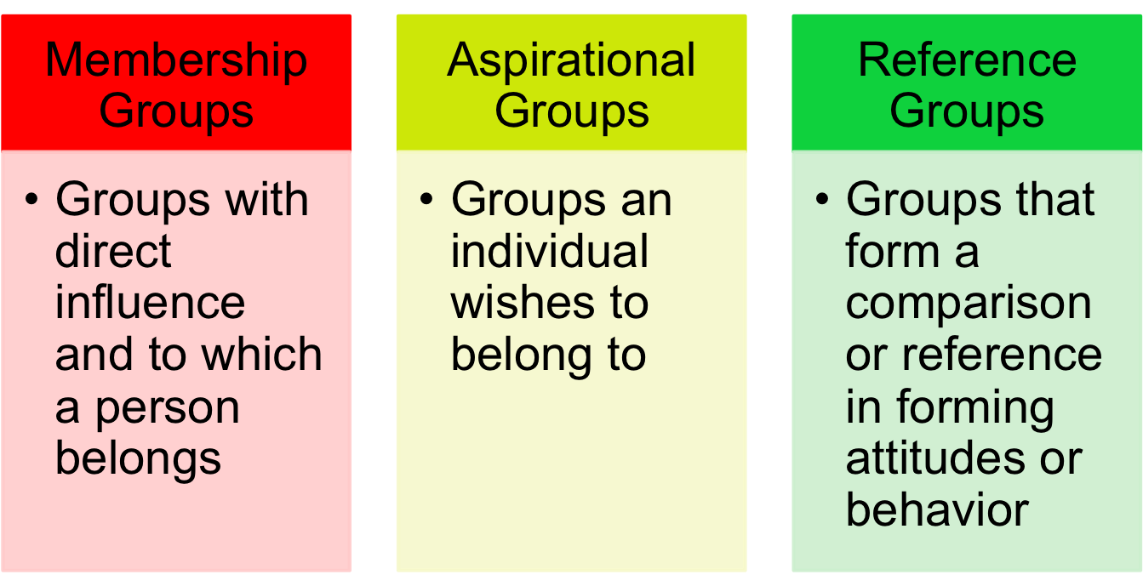
Characteristics Affecting Consumer Behavior
Groups and Social Networks

Slide 8
Characteristics Affecting Consumer Behavior
Groups and Social Networks
Word-of-mouth influence and buzz marketing
  Opinion leaders are people within a reference group who exert social influence on others
  Also called influentials or leading adopters
  Marketers identify them to use as brand ambassadors

Slide 9
Characteristics Affecting Consumer Behavior
Groups and Social Networks
Online social networks are online communities where people socialize or exchange information and opinions
Include blogs, social networking sites (facebook), virtual worlds (second life)

Slide 10
Characteristics Affecting Consumer Behavior
Social Factors
Family is the most important consumer-buying organization in society
Social roles and status are the groups, family, clubs, and organizations that a person belongs to that can define role and social status

Slide 11
Characteristics Affecting Consumer Behavior
Personal Factors
Age and life-cycle stage
RBC Royal Band stages
  Youth—younger than 18
  Getting started—18-35
  Builders—35-50
  Accumulators—50–60
  Preservers—over 60

Slide 12
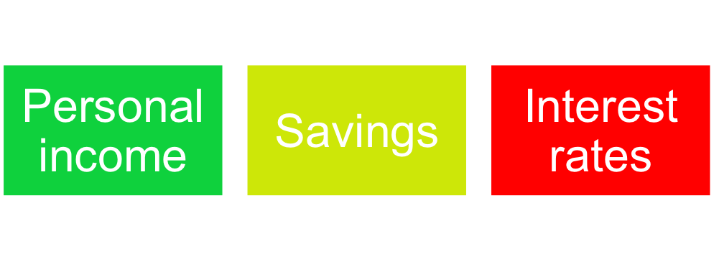
Characteristics Affecting Consumer Behavior
Personal Factors
Occupation affects the goods and services bought by consumers
Economic situation includes trends in:

Slide 13
Characteristics Affecting Consumer Behavior
Personal Factors
Lifestyle is a person’s pattern of living as expressed in his or her psychographics
Measures a consumer’s AIOs (activities, interests, opinions) to capture information about a person’s pattern of acting and interacting in the environment

Slide 14
Characteristics Affecting Consumer Behavior
Personal Factors
Personality and Self-Concept
  Personality refers to the unique psychological characteristics that lead to consistent and lasting responses to the consumer’s environment

Slide 15
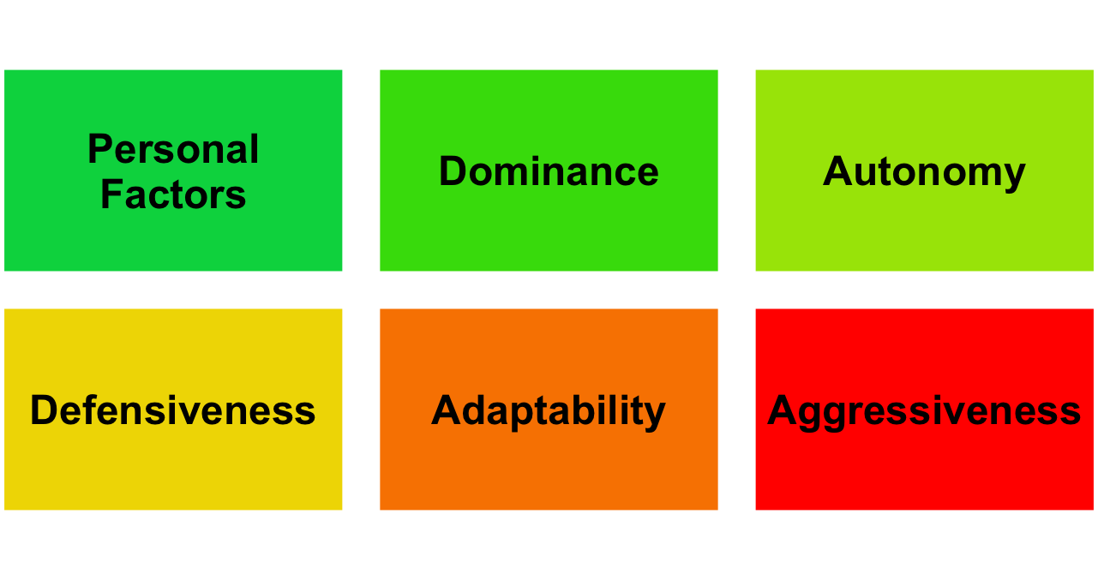
Characteristics Affecting Consumer Behavior

Slide 16
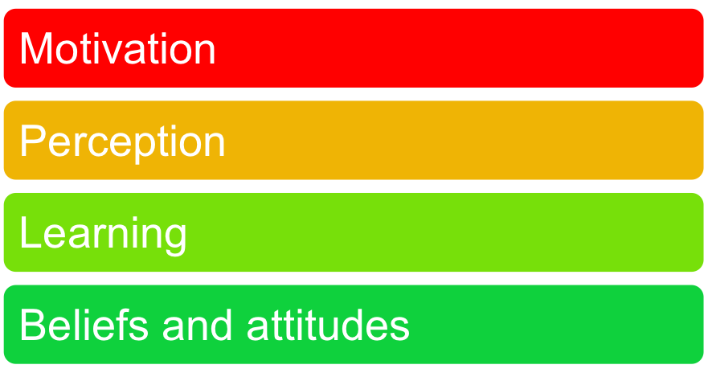
Characteristics Affecting Consumer Behavior
Psychological Factors

Slide 17
Characteristics Affecting Consumer Behavior
Psychological Factors
Motivation
A motive is a need that is sufficiently pressing to direct the person to seek satisfaction
Motivation research refers to qualitative research designed to probe consumers’ hidden, subconscious motivations

Slide 18
Characteristics Affecting Consumer Behavior
Psychological Factors
Perception is the process by which people select, organize, and interpret information to form a meaningful picture of the world from three perceptual processes
  Selective attention
  Selective distortion
  Selective retention

Slide 19
Characteristics Affecting Consumer Behavior
Psychological Factors
Selective attention is the tendency for people to screen out most of the information to which they are exposed
Selective distortion is the tendency for people to interpret information in a way that will support what they already believe
Selective retention is the tendency to remember good points made about a brand they favor and forget good points about competing brands

Slide 20
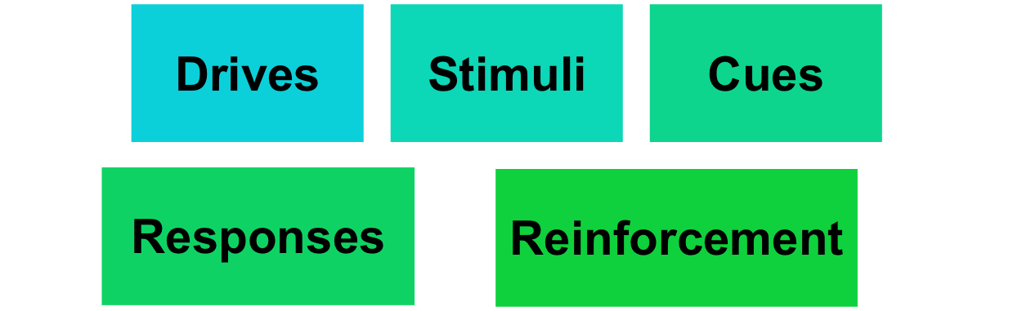
Characteristics Affecting Consumer Behavior
Psychological Factors
Learning is the change in an individual’s behavior arising from experience and occurs through interplay of:

Slide 21
Characteristics Affecting Consumer Behavior
Psychological Factors
Beliefs and Attitudes
Belief is a descriptive thought that a person has about something based on:
Knowledge
Opinion
Faith

Slide 22
Characteristics Affecting Consumer Behavior
Psychological Factors
Attitudes describe a person’s relatively consistent evaluations, feelings, and tendencies toward an object or idea

Slide 23
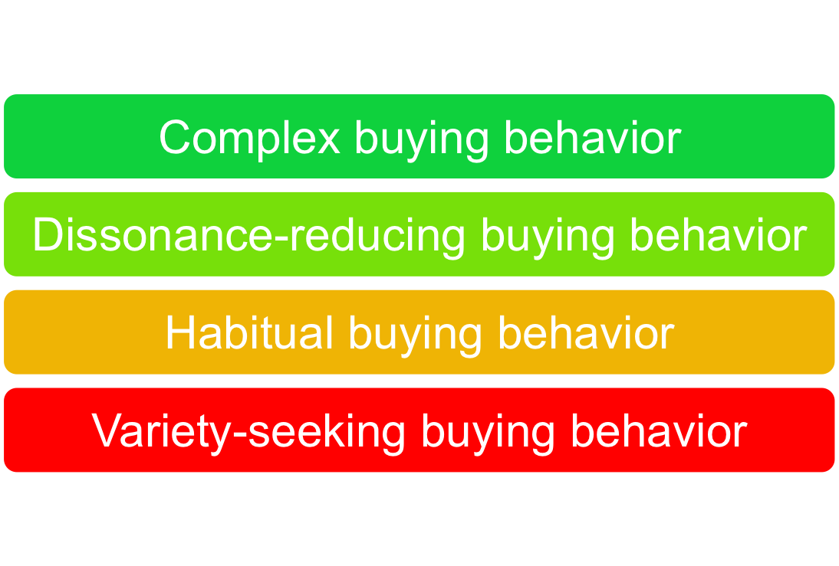
Types of Buying Decision Behavior

Slide 24
The Buyer Decision Process
Need Recognition
Occurs when the buyer recognizes a problem or need triggered by:
  Internal stimuli
  External stimuli

Slide 25
The Buyer Decision Process
Information Search
Sources of Information
Personal sources—family and friends
Commercial sources—advertising, Internet
Public sources—mass media, consumer organizations
Experiential sources—handling, examining, using the product

Slide 26
The Buyer Decision Process
Evaluation of Alternatives
How the consumer processes information to arrive at brand choices

Slide 27
The Buyer Decision Process
Purchase Decision
The act by the consumer to buy the most preferred brand
The purchase decision can be affected by:
  Attitudes of others
  Unexpected situational factors

Slide 28
The Buyer Decision Process
Postpurchase Decision
The satisfaction or dissatisfaction that the consumer feels about the purchase
Relationship between:
  Consumer’s expectations
  Product’s perceived performance
The larger the gap between expectation and performance, the greater the consumer’s dissatisfaction
Cognitive dissonance is the discomfort caused by a postpurchase conflict

Slide 29
The Buyer Decision Process
Post-Purchase Decision
Customer satisfaction is a key to building profitable relationships with consumers—to keeping and growing consumers and reaping their customer lifetime value

Slide 30
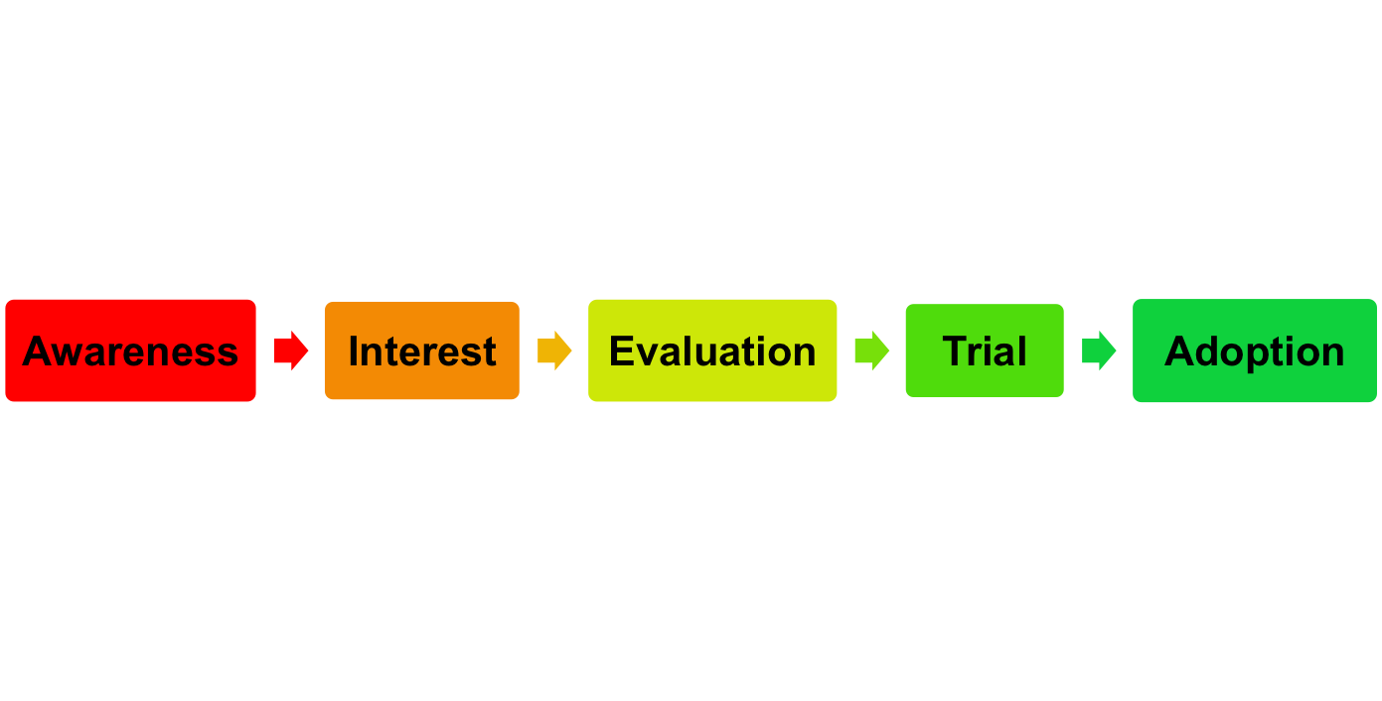
The Buyer Decision Process for New Products
Adoption process is the mental process an individual goes through from first learning about an innovation to final regular use.
Stages in the process include:

Slide 31
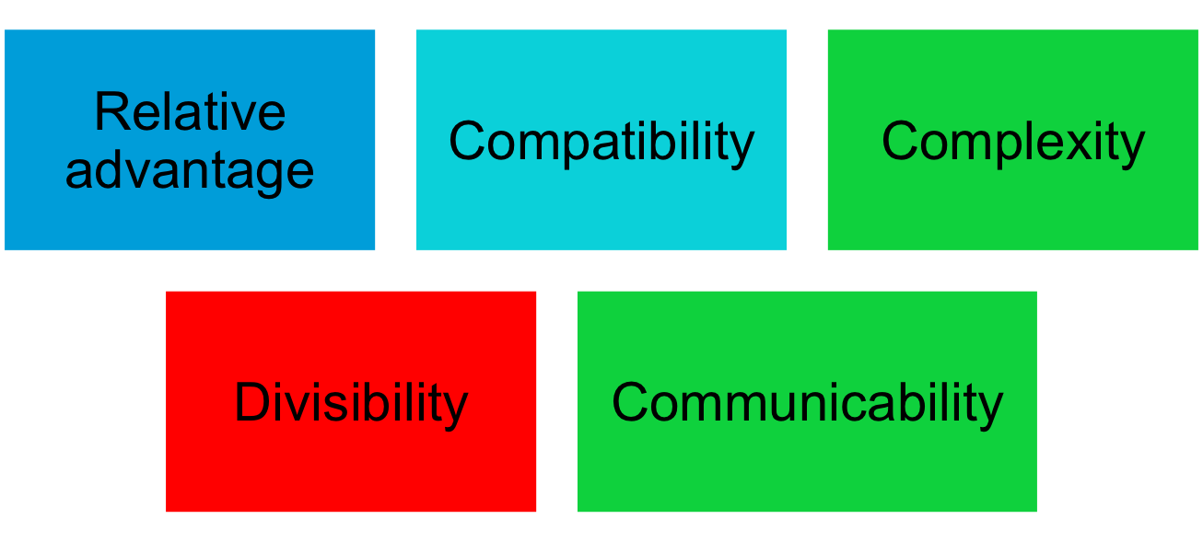
The Buyer Decision Process for New Products
Influence of Product Characteristics
on Rate of Adoption

Slide 32

All rights reserved. No part of this publication may be reproduced, stored in a retrieval system, or transmitted, in any form or by any means, electronic, mechanical, photocopying, recording, or otherwise, without the prior written permission of the publisher. Printed in the United States of America.
Copyright © 2010 Pearson Education, Inc.
Publishing as Prentice Hall

